Slide 1




WEAPON & AMMUNITION MANAGEMENT SYSTEM
DATA STRUCTURES & ALGORITHMS

Slide 2
Team Members
M.FAHAD ALI
M.BILAL CHAUDHRY
M.MUZAMMIL

Slide 3
ABSTRACT
This project presents an Inventory Management System(Defence Asset Inventory) implemented using C++ and fundamental Data Structures and Algorithms (DSA). The system manages different categories of items such as handguns, rifles, armor, and ammunition.

Slide 4
INTRODUCTION
Inventory management is an essential component of many real-world systems such as warehouses, military storage, and retail stores. Efficient inventory handling requires fast searching, structured storage, and easy updates. Data Structures play a crucial role in optimizing these operations.

Slide 5

OBJECTIVE
To design an inventory management system using C++
To demonstrate practical applications of Data Stuctures and Algorithms

Slide 6
DATA STRUCTURES & ALGORITHMS USED
Linked Lists
Recursion
Binary Search Trees
Sorting Algorithm

Slide 7
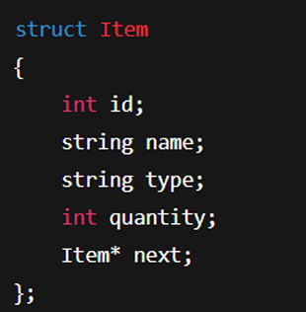

LINKED LISTS & ALGORITHMS
The inventory and log system are implemented using singly linked lists.
Advantage:
Efficient insertion operations
No fixed size limitation
A bubble-sort-like approach is used to
sort linked list elements by:
Item name
Item type
Item ID

Slide 8
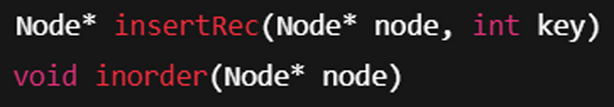
RECURSION & BST
Searching items in the inventory.
The BST is used to store item IDs and display them in sorted order.
Faster searching compared to linear structures (average case).

Slide 9
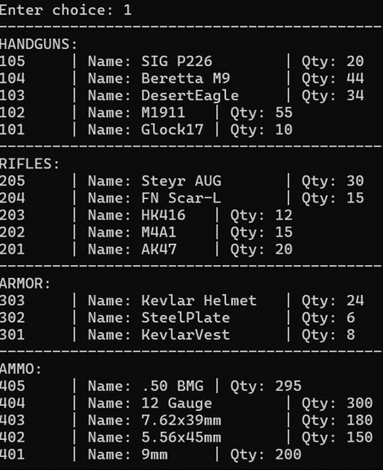
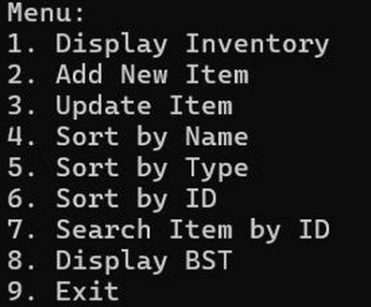
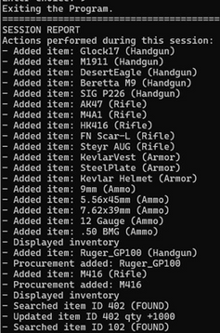
OUTPUT RESULTS
Menu-Driven Design
Displays categorized inventory
Sorts items correctly
Displays sorted item IDs using BST inorder traversal
Generates a detailed session activity report upon exit

Slide 10
Conclusion
This project successfully demonstrates the use of Data Structures such as Linked Lists, Recursion, Sorting Algorithms, and Binary Search Trees in building an efficient inventory management system. The implementation improved understanding of how DSA concepts are applied in real-world applications
The project highlights the importance of data organization, efficient searching, and structured programming in software development.

Slide 11
Thank You

